Slide 1
Controller Design based on State Space Model

Slide 2
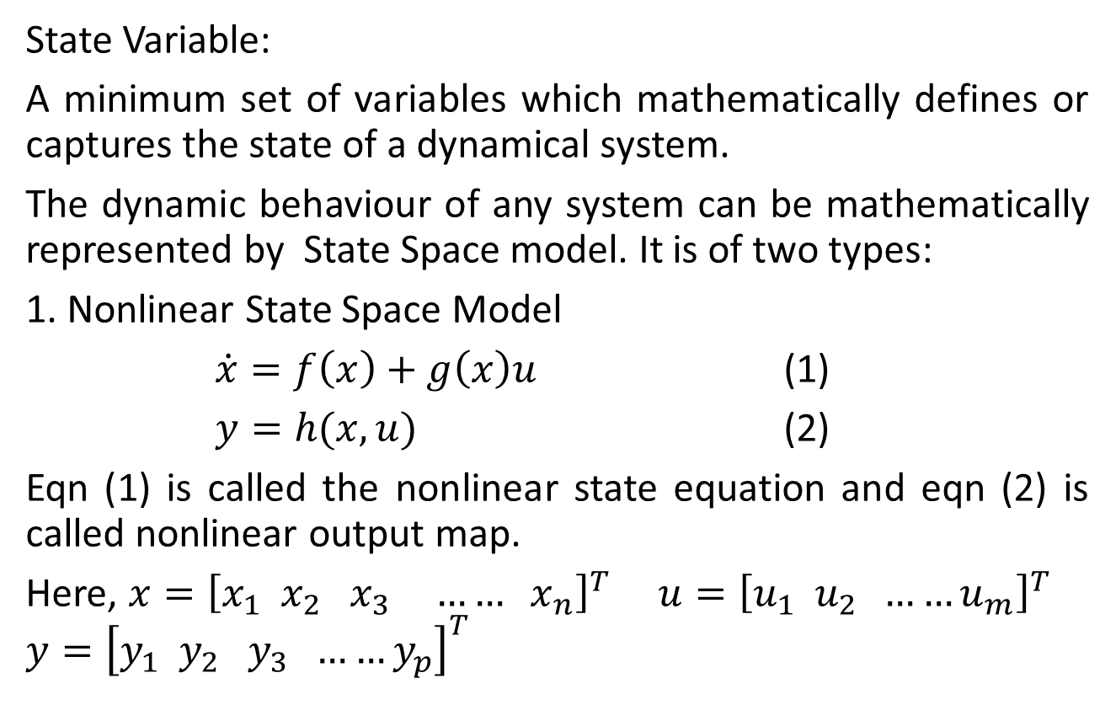
State Space Model
State Variable:
A minimum set of variables which mathematically defines or captures the state of a dynamical system.
The dynamic behaviour of any system can be mathematically represented by State Space model. It is of two types:
1. Nonlinear State Space Model
$\dot{x}=f\left(x\right)+g\left(x\right)u$ (1)
$y=h(x,u)$ (2)
Eqn (1) is called the nonlinear state equation and eqn (2) is called nonlinear output map.
Here, $x={\left[x_{1} x_{2} x_{3} …… x_{n}\right]}^{T}$ $u={\left[u_{1} u_{2} ……u_{m}\right]}^{T}$
$$y={\left[y_{1} y_{2} y_{3} ……y_{p}\right]}^{T}$$

Slide 3

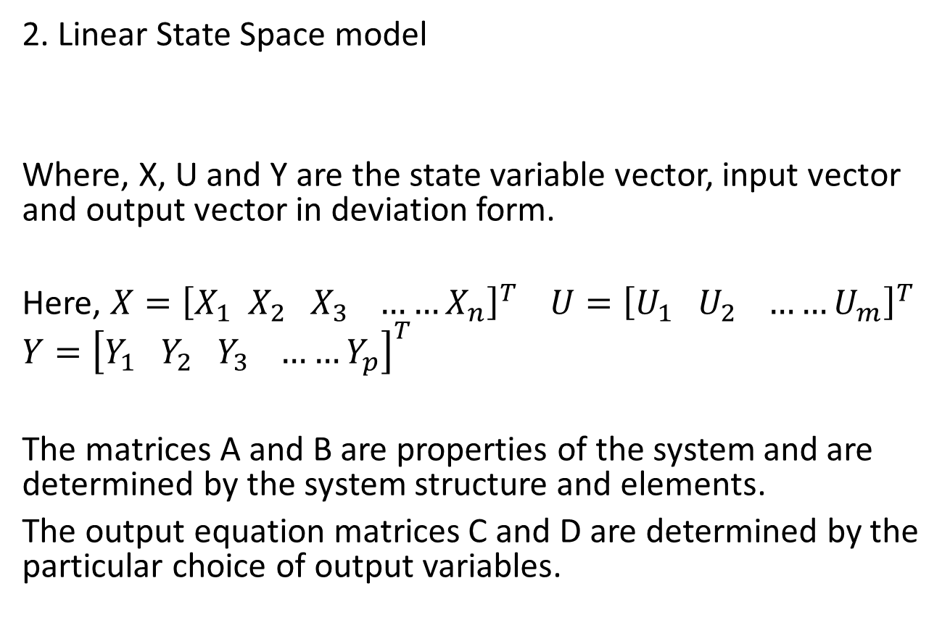
State Space Model
2. Linear State Space model
Where, X, U and Y are the state variable vector, input vector and output vector in deviation form.
Here, $X={\left[X_{1} X_{2} X_{3} ……X_{n}\right]}^{T}$ $U={\left[U_{1} U_{2} ……U_{m}\right]}^{T}$
$$Y={\left[Y_{1} Y_{2} Y_{3} ……Y_{p}\right]}^{T}$$
The matrices A and B are properties of the system and are determined by the system structure and elements.
The output equation matrices C and D are determined by the particular choice of output variables.
$$\dot{X}=AX+BU$$
$$Y=CX+DU$$

Slide 4
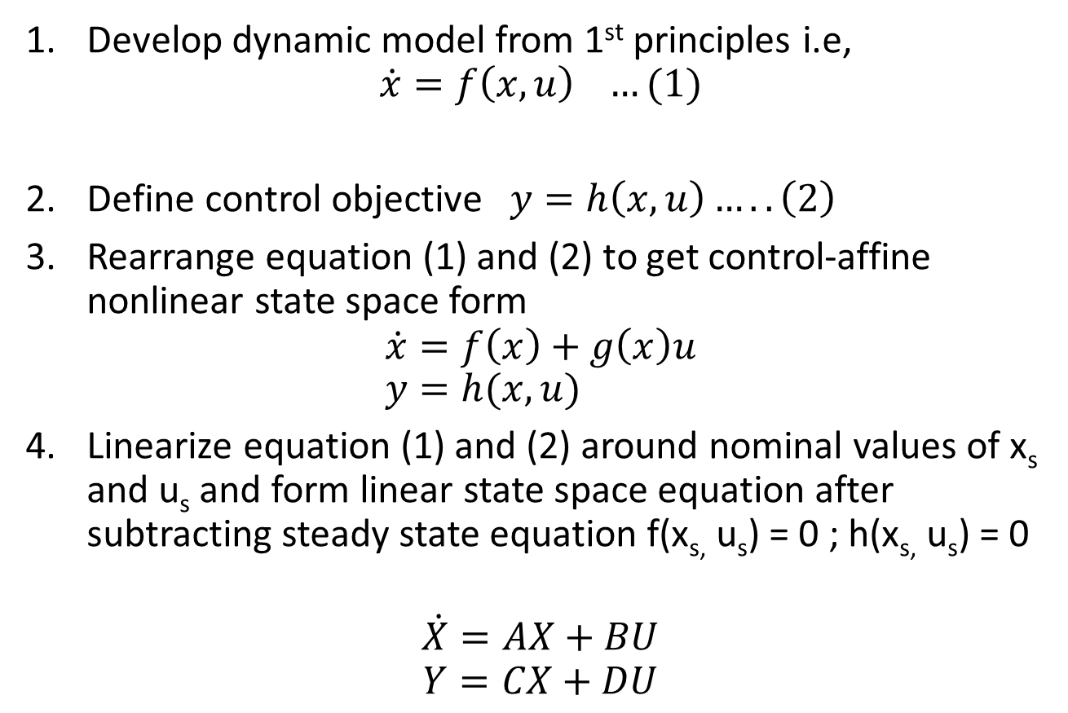
Development State Space Model
Develop dynamic model from 1st principles i.e,
$$\dot{x}=f\left(x,u\right) …(1)$$
Define control objective $y=h\left(x,u\right)…..\left(2\right)$
Rearrange equation (1) and (2) to get control-affine nonlinear state space form
$$\dot{x}=f\left(x\right)+g\left(x\right)u \\ y=h(x,u)$$
Linearize equation (1) and (2) around nominal values of x_{s} and u_{s} and form linear state space equation after subtracting steady state equation f(x_{s,} u_{s}) = 0 ; h(x_{s,} u_{s}) = 0
$$\dot{X}=AX+BU$$
$$Y=CX+DU$$

Slide 5
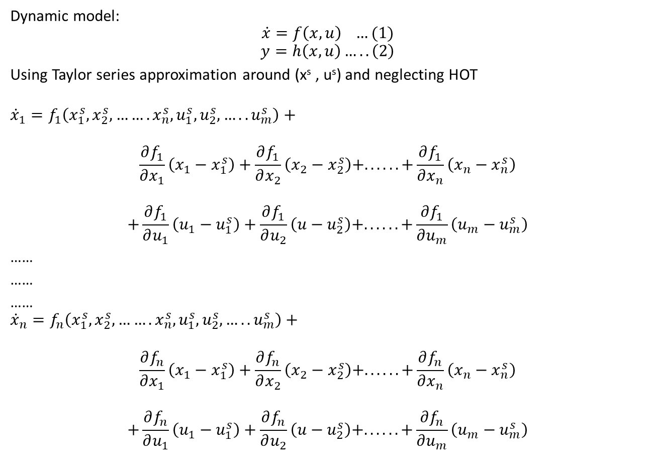
Dynamic model:
$$\dot{x}=f\left(x,u\right) …(1)$$
$$y=h\left(x,u\right)…..\left(2\right)$$
Using Taylor series approximation around (x^{s} , u^{s}) and neglecting HOT
$${\dot{x}}_{1}=f_{1}\left(x_{1}^{s},x_{2}^{s},…….x_{n}^{s},u_{1}^{s},u_{2}^{s},…..u_{m}^{s}\right)+$$
$$\frac{∂f_{1}}{∂x_{1}}\left(x_{1}−x_{1}^{s}\right)+\frac{∂f_{1}}{∂x_{2}}\left(x_{2}−x_{2}^{s}\right)+. . . . . .+\frac{∂f_{1}}{∂x_{n}}\left(x_{n}−x_{n}^{s}\right)$$
$$+\frac{∂f_{1}}{∂u_{1}}\left(u_{1}−u_{1}^{s}\right)+\frac{∂f_{1}}{∂u_{2}}\left(u−u_{2}^{s}\right)+. . . . . .+\frac{∂f_{1}}{∂u_{m}}\left(u_{m}−u_{m}^{s}\right)$$
……
……
……
$${\dot{x}}_{n}=f_{n}\left(x_{1}^{s},x_{2}^{s},…….x_{n}^{s},u_{1}^{s},u_{2}^{s},…..u_{m}^{s}\right)+$$
$$\frac{∂f_{n}}{∂x_{1}}\left(x_{1}−x_{1}^{s}\right)+\frac{∂f_{n}}{∂x_{2}}\left(x_{2}−x_{2}^{s}\right)+. . . . . .+\frac{∂f_{n}}{∂x_{n}}\left(x_{n}−x_{n}^{s}\right)$$
$$+\frac{∂f_{n}}{∂u_{1}}\left(u_{1}−u_{1}^{s}\right)+\frac{∂f_{n}}{∂u_{2}}\left(u−u_{2}^{s}\right)+. . . . . .+\frac{∂f_{n}}{∂u_{m}}\left(u_{m}−u_{m}^{s}\right)$$

Slide 6
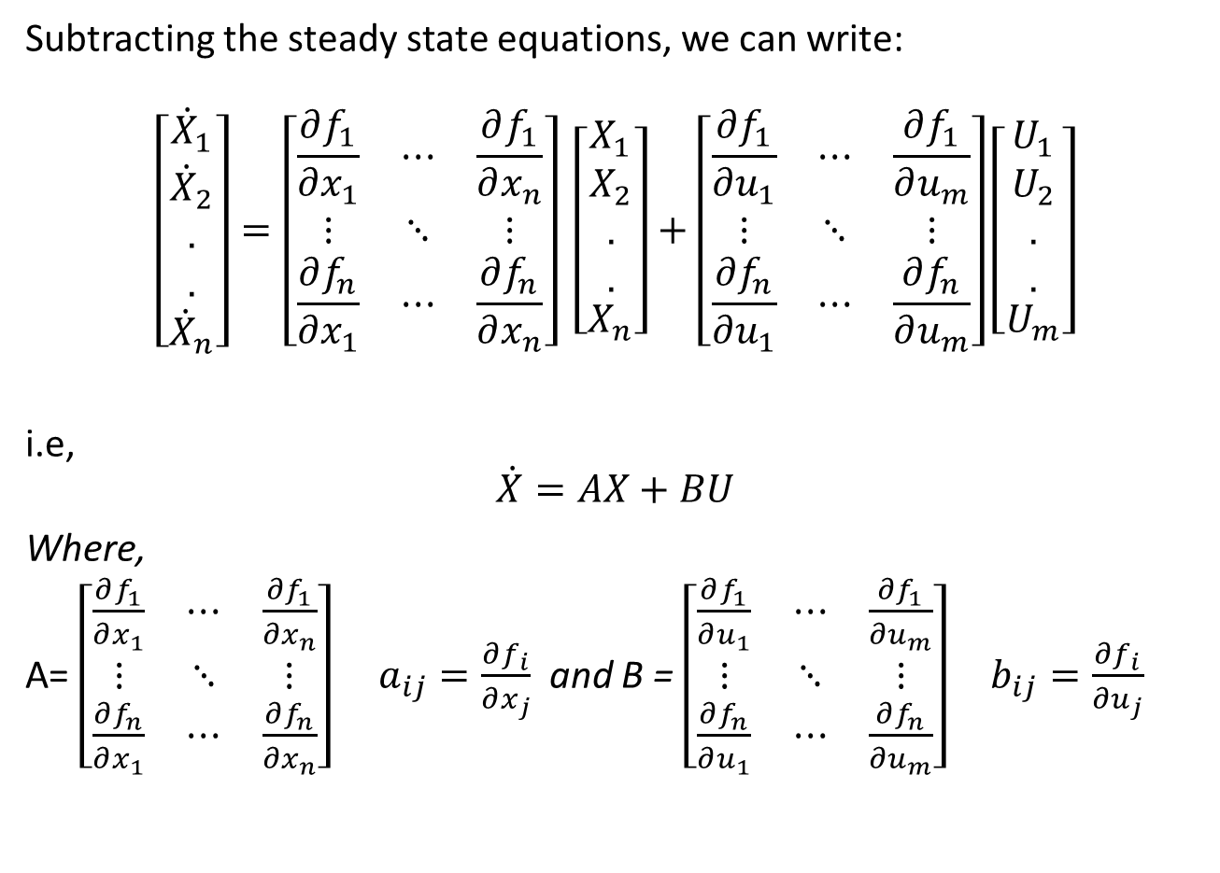
Subtracting the steady state equations, we can write:
$$\left[\begin{matrix}{\dot{X}}_{1} \\ \begin{aligned}{\dot{X}}_{2} \\ . \\ .\end{aligned} \\ {\dot{X}}_{n}\end{matrix}\right]=\left[\begin{matrix}\frac{∂f_{1}}{∂x_{1}} & ⋯ & \frac{∂f_{1}}{∂x_{n}} \\ ⋮ & ⋱ & ⋮ \\ \frac{∂f_{n}}{∂x_{1}} & ⋯ & \frac{∂f_{n}}{∂x_{n}}\end{matrix}\right] \left[\begin{matrix}X_{1} \\ \begin{aligned}X_{2} \\ . \\ .\end{aligned} \\ X_{n}\end{matrix}\right]+\left[\begin{matrix}\frac{∂f_{1}}{∂u_{1}} & ⋯ & \frac{∂f_{1}}{∂u_{m}} \\ ⋮ & ⋱ & ⋮ \\ \frac{∂f_{n}}{∂u_{1}} & ⋯ & \frac{∂f_{n}}{∂u_{m}}\end{matrix}\right]\left[\begin{matrix}U_{1} \\ \begin{aligned}U_{2} \\ . \\ .\end{aligned} \\ U_{m}\end{matrix}\right]$$
i.e,
$$\dot{X}=AX+BU$$
Where,
A= $\left[\begin{matrix}\frac{∂f_{1}}{∂x_{1}} & ⋯ & \frac{∂f_{1}}{∂x_{n}} \\ ⋮ & ⋱ & ⋮ \\ \frac{∂f_{n}}{∂x_{1}} & ⋯ & \frac{∂f_{n}}{∂x_{n}}\end{matrix}\right]$ $a_{ij}=\frac{∂f_{i}}{∂x_{j}}$ and B = $\left[\begin{matrix}\frac{∂f_{1}}{∂u_{1}} & ⋯ & \frac{∂f_{1}}{∂u_{m}} \\ ⋮ & ⋱ & ⋮ \\ \frac{∂f_{n}}{∂u_{1}} & ⋯ & \frac{∂f_{n}}{∂u_{m}}\end{matrix}\right] b_{ij}=\frac{∂f_{i}}{∂u_{j}}$

Slide 7
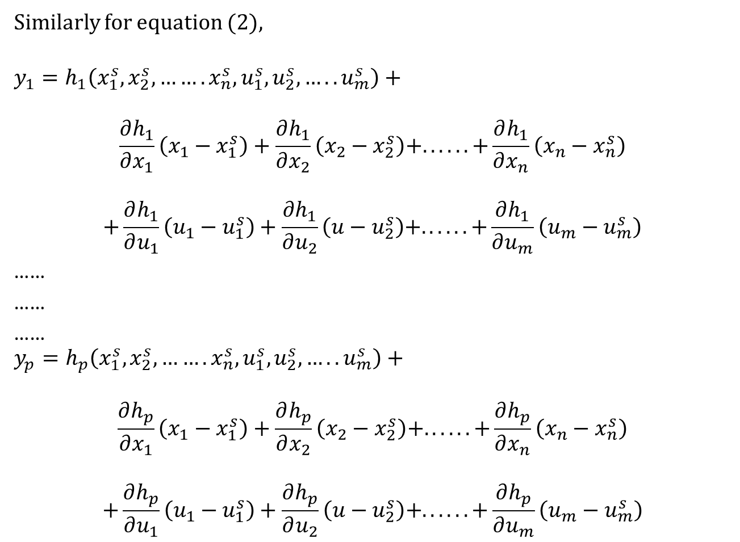
Similarly for equation (2),
$$y_{1}=h_{1}\left(x_{1}^{s},x_{2}^{s},…….x_{n}^{s},u_{1}^{s},u_{2}^{s},…..u_{m}^{s}\right)+$$
$$\frac{∂h_{1}}{∂x_{1}}\left(x_{1}−x_{1}^{s}\right)+\frac{∂h_{1}}{∂x_{2}}\left(x_{2}−x_{2}^{s}\right)+. . . . . .+\frac{∂h_{1}}{∂x_{n}}\left(x_{n}−x_{n}^{s}\right)$$
$$+\frac{∂h_{1}}{∂u_{1}}\left(u_{1}−u_{1}^{s}\right)+\frac{∂h_{1}}{∂u_{2}}\left(u−u_{2}^{s}\right)+. . . . . .+\frac{∂h_{1}}{∂u_{m}}\left(u_{m}−u_{m}^{s}\right)$$
……
……
……
$$y_{p}=h_{p}\left(x_{1}^{s},x_{2}^{s},…….x_{n}^{s},u_{1}^{s},u_{2}^{s},…..u_{m}^{s}\right)+$$
$$\frac{∂h_{p}}{∂x_{1}}\left(x_{1}−x_{1}^{s}\right)+\frac{∂h_{p}}{∂x_{2}}\left(x_{2}−x_{2}^{s}\right)+. . . . . .+\frac{∂h_{p}}{∂x_{n}}\left(x_{n}−x_{n}^{s}\right)$$
$$+\frac{∂h_{p}}{∂u_{1}}\left(u_{1}−u_{1}^{s}\right)+\frac{∂h_{p}}{∂u_{2}}\left(u−u_{2}^{s}\right)+. . . . . .+\frac{∂h_{p}}{∂u_{m}}\left(u_{m}−u_{m}^{s}\right)$$

Slide 8
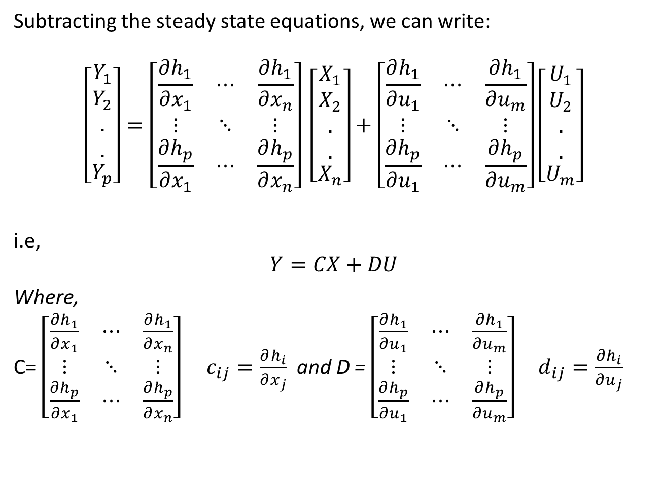
Subtracting the steady state equations, we can write:
$$\left[\begin{matrix}Y_{1} \\ \begin{aligned}Y_{2} \\ . \\ .\end{aligned} \\ Y_{p}\end{matrix}\right]=\left[\begin{matrix}\frac{∂h_{1}}{∂x_{1}} & ⋯ & \frac{∂h_{1}}{∂x_{n}} \\ ⋮ & ⋱ & ⋮ \\ \frac{∂h_{p}}{∂x_{1}} & ⋯ & \frac{∂h_{p}}{∂x_{n}}\end{matrix}\right] \left[\begin{matrix}X_{1} \\ \begin{aligned}X_{2} \\ . \\ .\end{aligned} \\ X_{n}\end{matrix}\right]+\left[\begin{matrix}\frac{∂h_{1}}{∂u_{1}} & ⋯ & \frac{∂h_{1}}{∂u_{m}} \\ ⋮ & ⋱ & ⋮ \\ \frac{∂h_{p}}{∂u_{1}} & ⋯ & \frac{∂h_{p}}{∂u_{m}}\end{matrix}\right]\left[\begin{matrix}U_{1} \\ \begin{aligned}U_{2} \\ . \\ .\end{aligned} \\ U_{m}\end{matrix}\right]$$
i.e,
$$Y=CX+DU$$
Where,
C= $\left[\begin{matrix}\frac{∂h_{1}}{∂x_{1}} & ⋯ & \frac{∂h_{1}}{∂x_{n}} \\ ⋮ & ⋱ & ⋮ \\ \frac{∂h_{p}}{∂x_{1}} & ⋯ & \frac{∂h_{p}}{∂x_{n}}\end{matrix}\right]$ $c_{ij}=\frac{∂h_{i}}{∂x_{j}}$ and D = $\left[\begin{matrix}\frac{∂h_{1}}{∂u_{1}} & ⋯ & \frac{∂h_{1}}{∂u_{m}} \\ ⋮ & ⋱ & ⋮ \\ \frac{∂h_{p}}{∂u_{1}} & ⋯ & \frac{∂h_{p}}{∂u_{m}}\end{matrix}\right] d_{ij}=\frac{∂h_{i}}{∂u_{j}}$

Slide 9
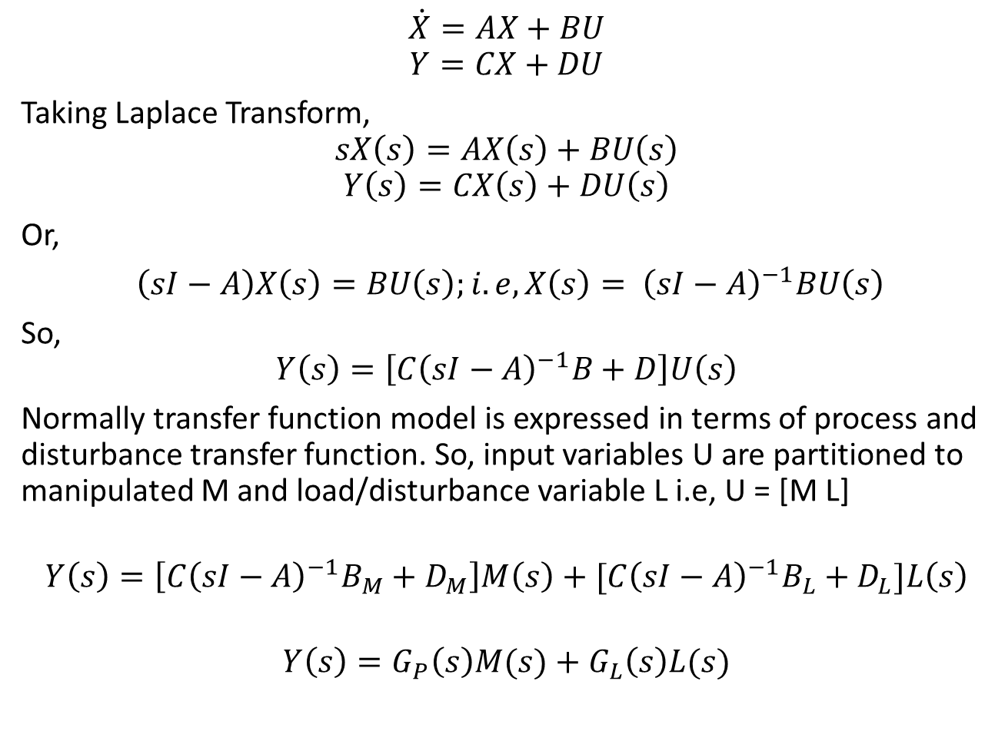
Linear State-space model to Transfer function model
$$\dot{X}=AX+BU$$
$$Y=CX+DU$$
Taking Laplace Transform,
$$sX\left(s\right)=AX\left(s\right)+BU\left(s\right)$$
$$Y\left(s\right)=CX\left(s\right)+DU\left(s\right)$$
Or,
$\left(sI−A\right)X\left(s\right)=BU\left(s\right);i.e, X\left(s\right)= {\left(sI−A\right)}^{−1}BU\left(s\right)$
So,
$$Y\left(s\right)=\left[C{\left(sI−A\right)}^{−1}B+D\right]U\left(s\right)$$
Normally transfer function model is expressed in terms of process and disturbance transfer function. So, input variables U are partitioned to manipulated M and load/disturbance variable L i.e, U = [M L]
$$Y\left(s\right)=\left[{C\left(sI−A\right)}^{−1}B_{M}+D_{M}\right]M\left(s\right)+{[C\left(sI−A\right)}^{−1}B_{L}+D_{L}]L\left(s\right)$$
$$Y\left(s\right)=G_{P}\left(s\right)M(s)+G_{L}\left(s\right)L(s)$$

Slide 10
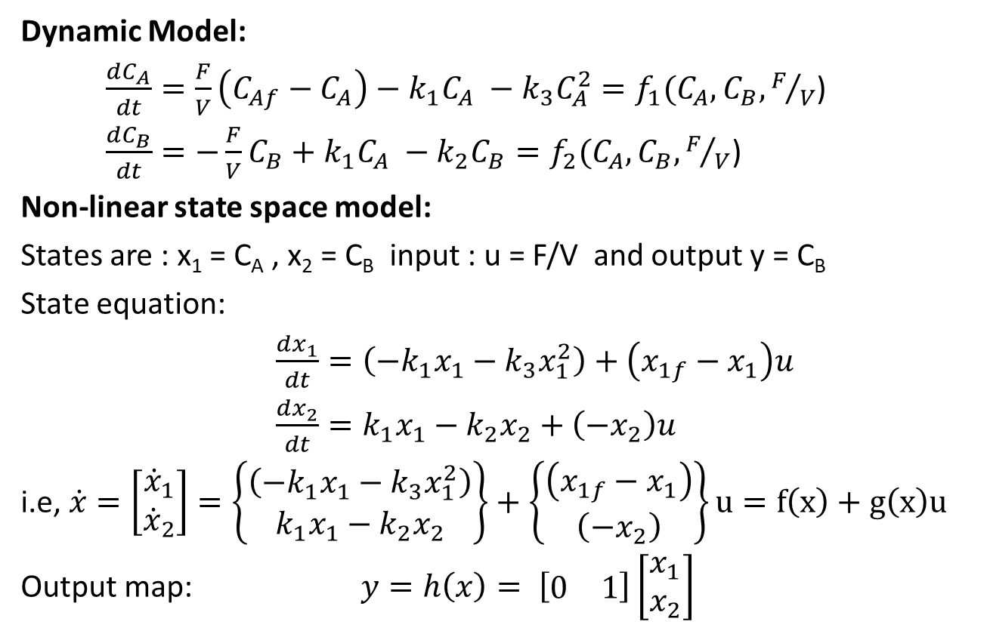
Example: Van De Vusse Reactor
Dynamic Model:
$\frac{dC_{A}}{dt}=\frac{F}{V}\left(C_{Af}−C_{A}\right)−k_{1}C_{A} −k_{3}C_{A}^{2}=f_{1}(C_{A},C_{B},F/V$)
$\frac{dC_{B}}{dt}=−\frac{F}{V}C_{B}+k_{1}C_{A} −k_{2}C_{B}=f_{2}(C_{A},C_{B},F/V$)
Non-linear state space model:
States are : x₁ = C_{A} , x₂ = C_{B} input : u = F/V and output y = C_{B}
State equation:
$\frac{dx_{1}}{dt}=\left(−k_{1}x_{1}−k_{3}x_{1}^{2}\right)+\left(x_{1f}−x_{1}\right)u$
$\frac{dx_{2}}{dt}=k_{1}x_{1}−k_{2}x_{2}+\left(−x_{2}\right)u$
i.e, $\dot{x}=\left[\begin{matrix}{\dot{x}}_{1} \\ {\dot{x}}_{2}\end{matrix}\right]=\left\{\begin{matrix}\left(−k_{1}x_{1}−k_{3}x_{1}^{2}\right) \\ k_{1}x_{1}−k_{2}x_{2}\end{matrix}\right\}+\left\{\begin{matrix}\left(x_{1f}−x_{1}\right) \\ \left(−x_{2}\right)\end{matrix}\right\}u=f\left(x\right)+g\left(x\right)u$
Output map: $y=h\left(x\right)= \left[\begin{matrix}0 & 1\end{matrix}\right]\left[\begin{matrix}x_{1} \\ x_{2}\end{matrix}\right]$

Slide 11
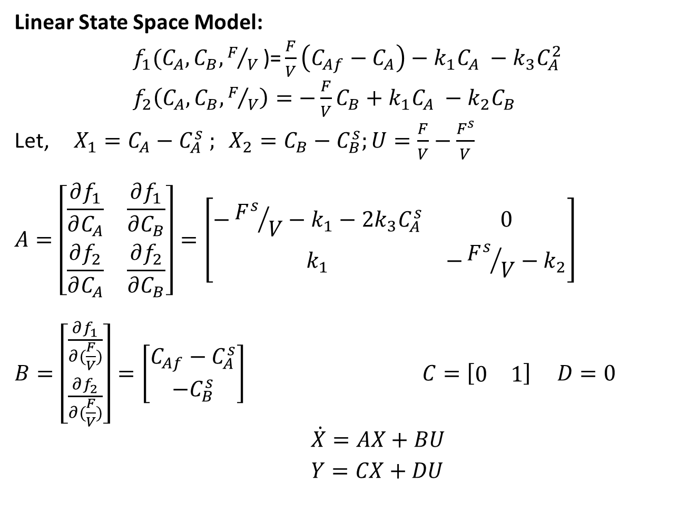
Example: Van De Vusse Reactor
Linear State Space Model:
$f_{1}(C_{A},C_{B},F/V\text{)}\text{=}\frac{F}{V}\left(C_{Af}−C_{A}\right)−k_{1}C_{A} −k_{3}C_{A}^{2}$
$f_{2}\left(C_{A},C_{B},F/V\right)=−\frac{F}{V}C_{B}+k_{1}C_{A} −k_{2}C_{B}$
Let, $X_{1}=C_{A}−C_{A}^{s} ; X_{2}=C_{B}−C_{B}^{s};U=\frac{F}{V}−\frac{F^{s}}{V}$
$$A=\left[\begin{matrix}\frac{∂f_{1}}{∂C_{A}} & \frac{∂f_{1}}{∂C_{B}} \\ \frac{∂f_{2}}{∂C_{A}} & \frac{∂f_{2}}{∂C_{B}}\end{matrix}\right]=\left[\begin{matrix}−{F^{s}}/V−k_{1}−2k_{3}C_{A}^{s} & 0 \\ k_{1} & −{F^{s}}/V−k_{2}\end{matrix}\right]$$
$B=\left[\begin{matrix}\frac{∂f_{1}}{∂(\frac{F}{V})} \\ \frac{∂f_{2}}{∂(\frac{F}{V})}\end{matrix}\right]=\left[\begin{matrix}C_{Af}−C_{A}^{s} \\ −C_{B}^{s}\end{matrix}\right] C=\left[\begin{matrix}0 & 1\end{matrix}\right] D=0$
$\dot{X}=AX+BU$
$Y=CX+DU$

Slide 12
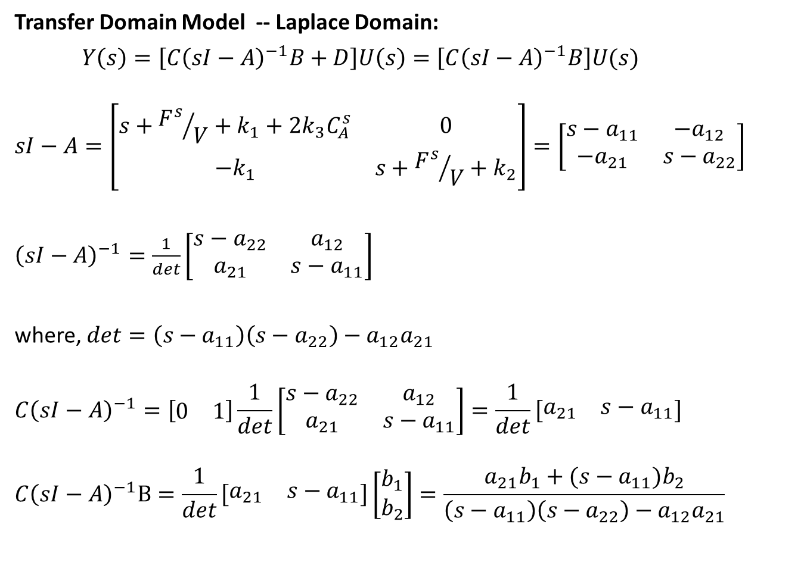
Example: Van De Vusse Reactor
Transfer Domain Model -- Laplace Domain:
$Y\left(s\right)=\left[C{\left(sI−A\right)}^{−1}B+D\right]U\left(s\right)=\left[C{\left(sI−A\right)}^{−1}B\right]U(s)$
$$sI−A=\left[\begin{matrix}s+{F^{s}}/V+k_{1}+2k_{3}C_{A}^{s} & 0 \\ −k_{1} & s+{F^{s}}/V+k_{2}\end{matrix}\right]=\left[\begin{matrix}s−a_{11} & −a_{12} \\ −a_{21} & s−a_{22}\end{matrix}\right]$$
${\left(sI−A\right)}^{−1}=\frac{1}{det}\left[\begin{matrix}s−a_{22} & a_{12} \\ a_{21} & s−a_{11}\end{matrix}\right]$
where, $det=\left(s−a_{11}\right)\left(s−a_{22}\right)−a_{12}a_{21}$
$$C{\left(sI−A\right)}^{−1}=\left[\begin{matrix}0 & 1\end{matrix}\right]\frac{1}{det}\left[\begin{matrix}s−a_{22} & a_{12} \\ a_{21} & s−a_{11}\end{matrix}\right]=\frac{1}{det}\left[\begin{matrix}a_{21} & s−a_{11}\end{matrix}\right]$$
$$C{\left(sI−A\right)}^{−1}B=\frac{1}{det}\left[\begin{matrix}a_{21} & s−a_{11}\end{matrix}\right]\left[\begin{matrix}b_{1} \\ b_{2}\end{matrix}\right]=\frac{a_{21}b_{1}+(s−a_{11})b_{2}}{\left(s−a_{11}\right)\left(s−a_{22}\right)−a_{12}a_{21}}$$

Slide 13
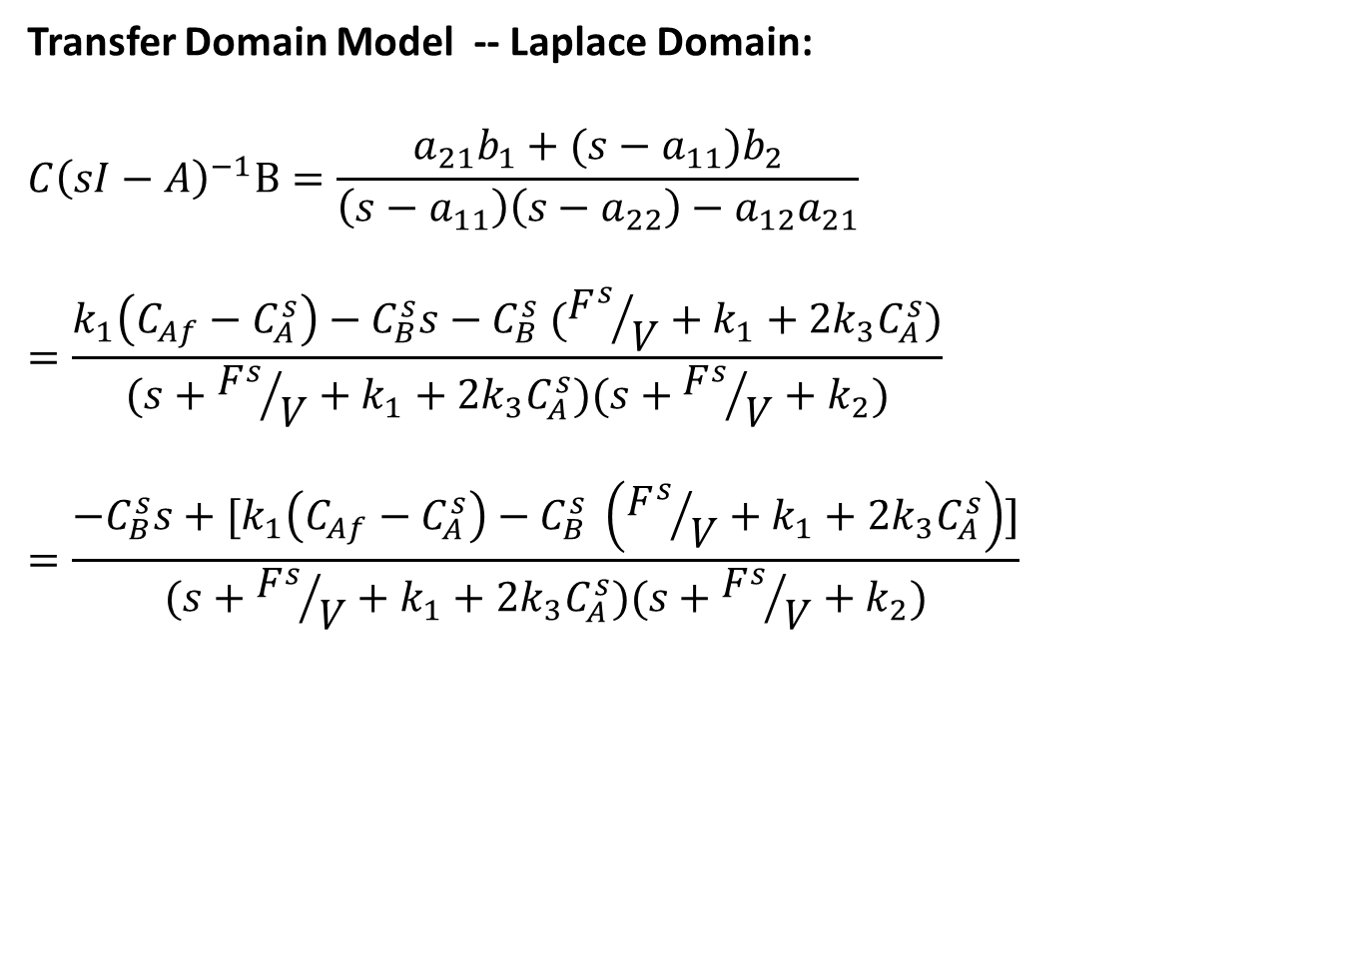
Example: Van De Vusse Reactor
Transfer Domain Model -- Laplace Domain:
$$C{\left(sI−A\right)}^{−1}B=\frac{a_{21}b_{1}+(s−a_{11})b_{2}}{\left(s−a_{11}\right)\left(s−a_{22}\right)−a_{12}a_{21}}$$
$$=\frac{k_{1}\left(C_{Af}−C_{A}^{s}\right)−C_{B}^{s}s−C_{B}^{s} ({F^{s}}/V+k_{1}+2k_{3}C_{A}^{s})}{(s+{F^{s}}/V+k_{1}+2k_{3}C_{A}^{s})(s+{F^{s}}/V+k_{2})}$$
$$=\frac{−C_{B}^{s}s+[k_{1}\left(C_{Af}−C_{A}^{s}\right)−C_{B}^{s} \left({F^{s}}/V+k_{1}+2k_{3}C_{A}^{s}\right)]}{(s+{F^{s}}/V+k_{1}+2k_{3}C_{A}^{s})(s+{F^{s}}/V+k_{2})}$$

Slide 14
State Space realization from Transfer Function
Process of converting transfer function to state space form is not unique.
Various realizations possible
All realizations are equivalent
One realization may have some advantages over others for a particular task
Possible realizations :
First Companion form (Controllable Canonical Form)
Jordan Canonical form
Alternate first companion form (Toeplitz form)
Second Companion form (Observable canonical form)

Slide 15
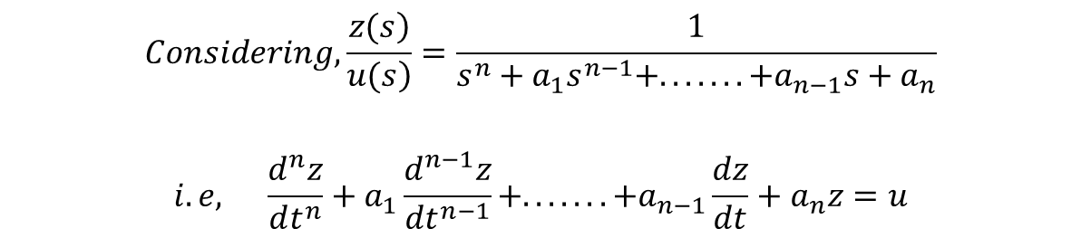
Controllable Canonical Form
Consider Laplace domain transfer function
$$\begin{matrix}\begin{aligned}Considering,\frac{\left.z(s\right)}{\left.u(s\right)}=\frac{1}{s^{n}+a_{1}s^{n−1}+.......+a_{n−1}s+a_{n}} \\ \end{aligned} \\ \\ i.e, \frac{d^{n}z}{dt^{n}}+a_{1}\frac{d^{n−1}z}{dt^{n−1}}+.......+a_{n−1}\frac{dz}{dt}+a_{n}z=u\end{matrix}$$

Slide 16
Controllable Canonical Form
Let us choose the states x₁ to x_{n} as,
Therefore, the state equations are:

Slide 17

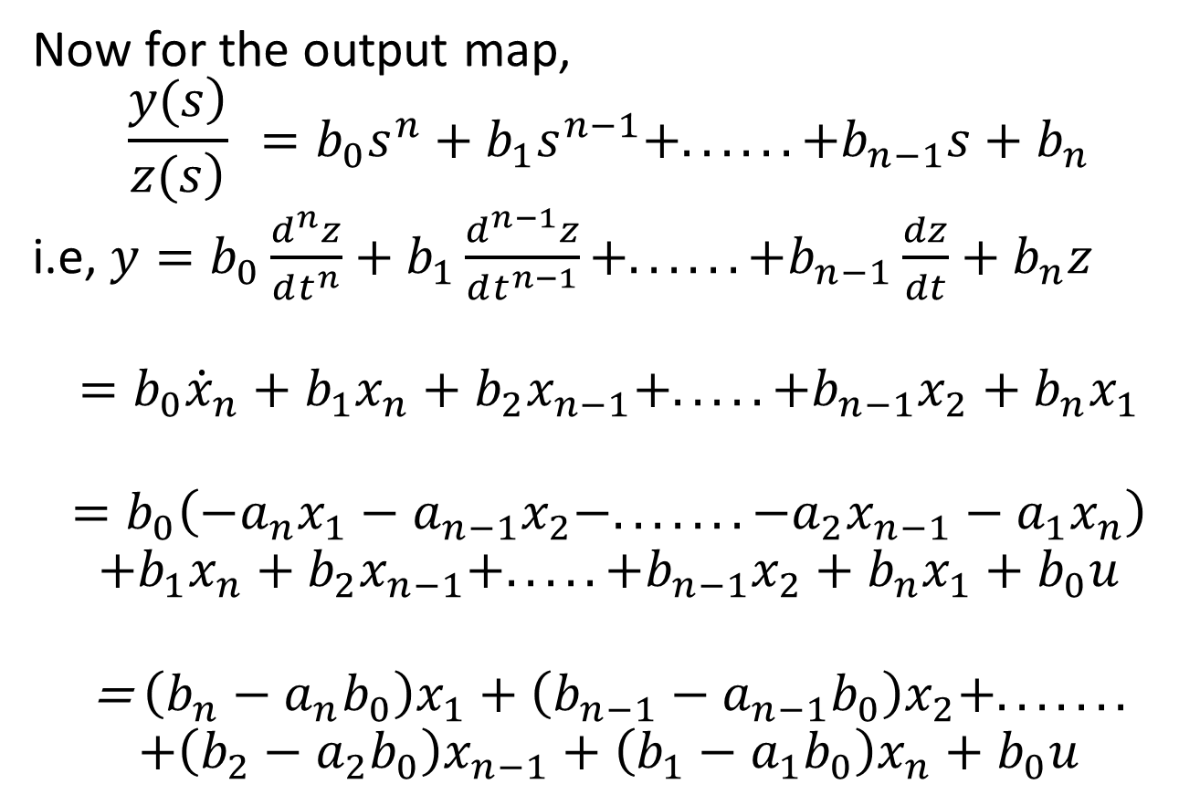
Controllable Canonical Form
Now for the output map,
$$\frac{\left.y(s\right)}{\left.z(s\right)} =b_{0}s^{n}+b_{1}s^{n−1}+......+b_{n−1}s+b_{n}$$
i.e, $y=b_{0}\frac{d^{n}z}{dt^{n}}+b_{1}\frac{d^{n−1}z}{dt^{n−1}}+......+b_{n−1}\frac{dz}{dt}+b_{n}z$
$$=b_{0}{\dot{x}}_{n}+b_{1}x_{n}+b_{2}x_{n−1}+.....+b_{n−1}x_{2}+b_{n}x_{1}$$
$$=b_{0}\left(−a_{n}x_{1}−a_{n−1}x_{2}−.......−a_{2}x_{n−1}−a_{1}x_{n}\right)$$
$$+b_{1}x_{n}+b_{2}x_{n−1}+.....+b_{n−1}x_{2}+b_{n}x_{1}+b_{0}u$$
$$\text{= }\left(b_{n}−a_{n}b_{0}\right)x_{1}+\left(b_{n−1}−a_{n−1}b_{0}\right)x_{2}+.......$$
$$+\left(b_{2}−a_{2}b_{0}\right)x_{n−1}+\left(b_{1}−a_{1}b_{0}\right)x_{n}+b_{0}u$$

Slide 18
Controllable Canonical Form
So, in standard vector-matrix form
and

Slide 19
Jordan Canonical Form
Consider Laplace domain transfer function
Therefore,
Where, are considered as the states of the system

Slide 20
Jordan Canonical Form
Therefore, the state equations are
and output map
What will happen in case of repeated roots?

Slide 21
Jordan Canonical Form (repeated roots)
For repeated roots, the partial fraction expression may be written as
Therefore,

Slide 22
Jordan Canonical Form (repeated roots)
Now the state equations are
Output map

Slide 23
Alternate Canonical form (Toeplitz form)
Consider the transfer function as
Define State equations and output map as the following:

Slide 24
Alternate Canonical form (Toeplitz form)
From the above definition, we can write

Slide 25
Alternate Canonical form (Toeplitz form)
Therefore,

Slide 26
Alternate Canonical form (Toeplitz form)
Equating the coefficients of
In vector-Matrix form,

Slide 27
2nd Companion form (Observer Canonical form)
Consider the transfer function
Rearranging the terms,

Slide 28
2nd Companion form (Observer Canonical form)
Rearranging the terms,
The equations now can be written as

Slide 29
2nd Companion form (Observer Canonical form)
In vector Matrix form,

Slide 30
2nd Companion form (Observer Canonical form)
On the other hand, if we formulate
Then,

